Slide 1
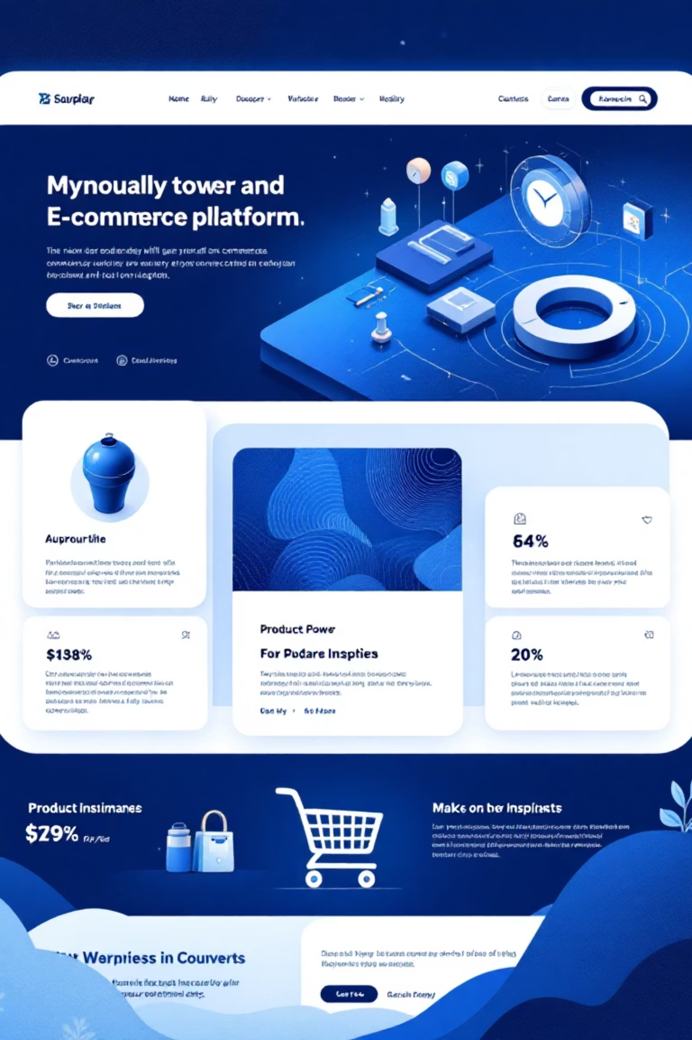
GoShop: A Modern E-Commerce Platform
Presented by Group 5
Team Members:
Course & Semester:
Manav Shah
INFO 6150 - Fall 2025
Krishi Parekh
Jayashree
Syrill Thevenin

Slide 2


Introducing GoShop: Bridging E-Commerce Gaps
GoShop revolutionises online retail by integrating customer, admin, and supplier operations into one seamless full-stack web application.
The Problem:
Our Solution:
Traditional e-commerce platforms often struggle with fragmented supplier management and inefficient real-time inventory control.
GoShop offers a unified platform for a dynamic three-sided marketplace, automating inventory and enhancing user experience.

Slide 3

GoShop's Robust Technology Stack
Built with modern, industry-standard technologies to ensure scalability, security, and a rich user experience.
Frontend Excellence:
Powerful Backend:
React.js: Component-based UI for dynamic interfaces.
Node.js & Express.js: Robust REST API development.
Bootstrap: Responsive design across all devices.
MongoDB: Flexible NoSQL database solution.
Stripe Elements: Secure, integrated payment forms.
JWT & OAuth: Secure authentication protocols.
Key Integrations:
Stripe: Seamless payment processing.
Google OAuth: Convenient social login.
OpenAI: AI-powered chatbot capabilities.
Multer: Efficient file uploads.

Slide 4



User-Centric Roles & Functionality
GoShop is designed with distinct interfaces and functionalities tailored for each of its three key user roles.
Customer:
Administrator:
Supplier:
Browse & search products effortlessly.
Comprehensive product management (CRUD).
View and confirm purchase orders.
Seamless shopping cart & secure checkout.
Customer order tracking & supplier order creation.
Efficiently ship orders.
Order tracking & AI chatbot support.
Update delivery statuses in real-time.
Overall inventory oversight.

Slide 5
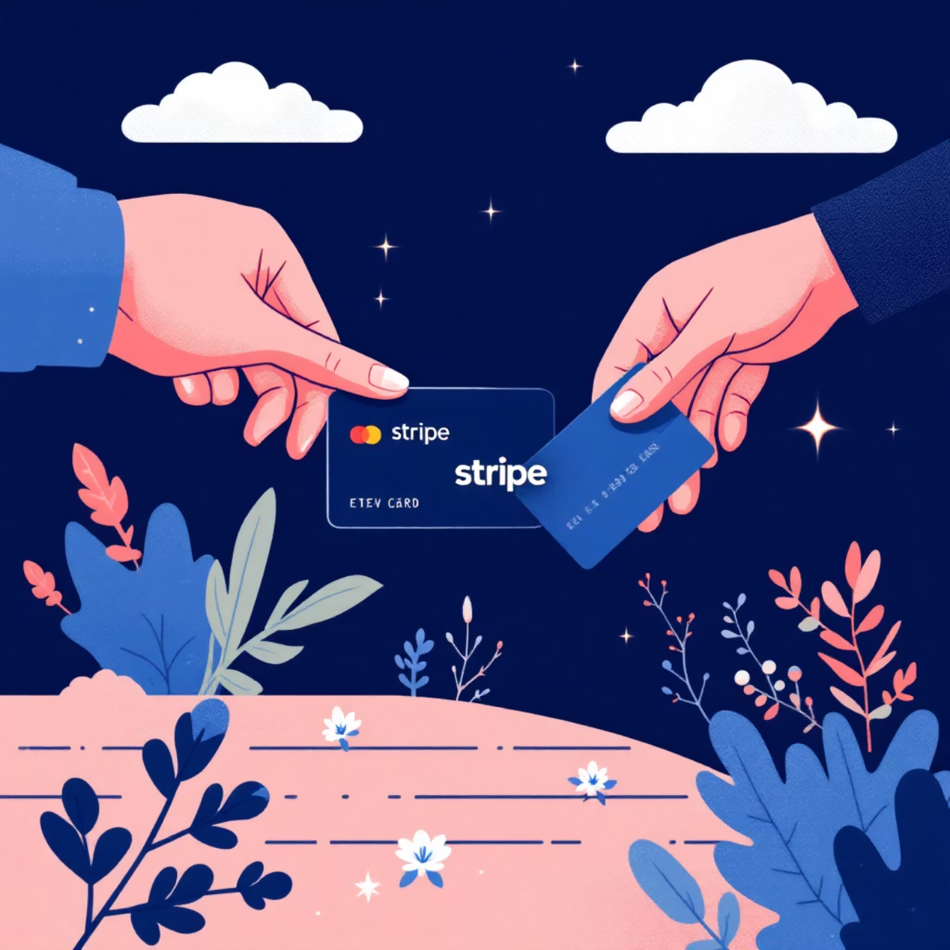

Secure Payments with Stripe Integration
Leveraging Stripe's industry-leading payment gateway for secure and seamless transactions.
Why Stripe?
Industry-Standard Security: PCI-compliant and 3D Secure support.
Easy Integration: Streamlined API for quick setup.
Developer-Friendly: Robust test mode for efficient development.
How It Works:
Customer proceeds to checkout, entering card details securely via Stripe Elements.
Payment is processed by the Stripe API; card data never touches our servers.
Order is confirmed, and stock is automatically updated upon successful payment.
Security Focus: All sensitive card data is handled directly by Stripe, ensuring maximum security and compliance.

Slide 6




Admin & Supplier Dashboards: Operational Command
Empowering administrators and suppliers with intuitive tools for efficient management.
Products Tab (Admin):
Customer Orders Tab (Admin):
Supplier Orders Tab (Admin):
Manage products effortlessly: add, edit, delete, upload images, set pricing, control stock, and categorise items.
Track all customer orders, update statuses, manage fulfillment, and access customer information.
Create purchase orders, select suppliers, monitor deliveries, and enable automatic restock upon arrival.

Slide 7




The AI Chatbot: Your 24/7 Customer Assistant
An intelligent, context-aware chatbot powered by OpenAI ChatGPT API for instant customer support.
Capabilities:
Answers product-related questions.
Provides shipping information and return policies.
Assists with order tracking and general queries.
Available around the clock for immediate support.
OpenAI Integration
Context-Aware Responses
Intuitive UI
Seamlessly integrates the ChatGPT API for advanced NLP.
Intelligently understands and responds to user queries.
Clean design with message history and real-time indicators.

Slide 8
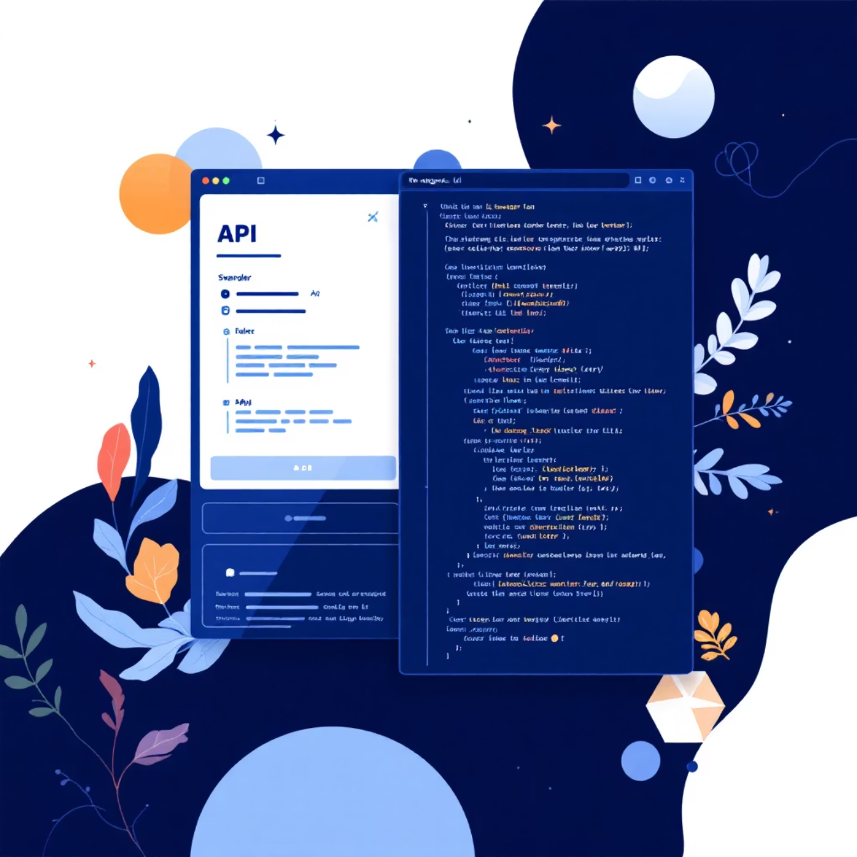

Comprehensive API Documentation: Swagger UI
Our RESTful API is fully documented using Swagger UI, providing an interactive and comprehensive guide.
What is Swagger?
An interactive tool offering user-friendly documentation for all API endpoints.
Key Features:
Detailed endpoint documentation.
Example request and response payloads.
“Try-it-out” functionality for live testing.
Clear schema definitions for all data models.
Documented Endpoints:
Includes authentication, product CRUD, orders, payments (Stripe), supplier orders, and file uploads.
Access the interactive documentation here: http://localhost:5001/api-docs

Slide 9





Multi-Layered Security for a Trusted Platform
GoShop prioritises security with robust measures across authentication, payments, and data protection.
Password Security
Uses bcrypt hashing with unique salt per user; passwords are never stored in plain text.
API Security
JWT authentication with token expiration and role-based access control for protected endpoints.
Payment Security
Leverages Stripe's PCI compliance and tokenised card data; all processing is server-side validated.
Data Protection
Utilises environment variables, CORS configuration, and input sanitisation to safeguard data.

Slide 10





GoShop: A Showcase of Modern Software Engineering
This project demonstrates our ability to deliver a production-ready e-commerce platform that addresses real-world business challenges.
1
Enterprise Architecture
2
Secure & Scalable
3
Multi-Role Management
4
Comprehensive Workflows
3
5
User Roles
Transaction Flows
Customer, Admin, Supplier.
Seamless end-to-end processes.
20+
3
API Endpoints
API Integrations
Robust and well-documented.
Stripe, Google OAuth, OpenAI.
GoShop is a testament to our team's technical skills, collaborative spirit, and commitment to building high-quality, impactful software solutions.

Slide 11
THANK YOU !

